Slide 1


Assessment and Management in a Differentiated Classroom
What Does it Look Like?
Jann H. Leppien, Ph.D.
jleppien@mt.net

Slide 2
While you’re waiting…
Directions:
Complete the chart to show what you know about Differentiated Instruction.
Write as much as you can.
Share with the people at your table.
Definition
Rationale
D.I.
Examples
Non-examples
Notes:
Good for pre-assessment; group formative assessment

Slide 3

To respect the dignity of young people means taking them seriously as whole human beings, not just as students. Who are these young people? What do they bring to school in terms of social and cultural experiences and identities? How old are they, and what expectations do school and society have for people that age? What is around them in terms of media messages, living conditions, community resources, and so on? Questions like these help us to see whole persons rather than just students in our classrooms. And when we do that, the door to respecting their dignity is opened.
A REASON TO TEACH by James A. Beane • Heinemann, Portsmouth, NH • p. 71-72

Slide 4
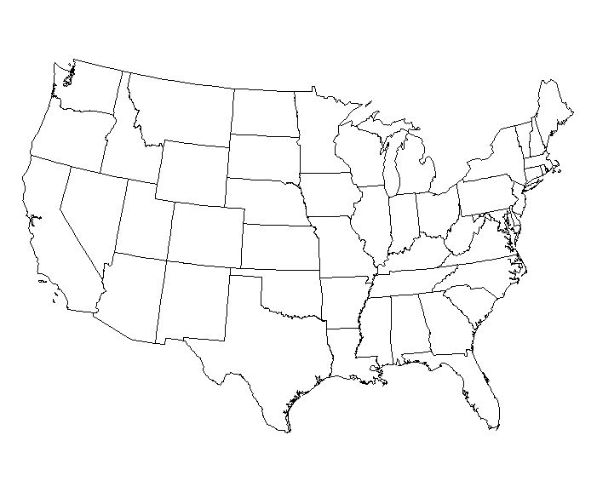
Instruction = the “route”; how we’ll get there
Disconnected Activities/
Misaligned Assessments
Curriculum =
The Destination
Summative Assessment =
What “getting there” looks like
Formative Assessment =
“Are we there yet?”
Jessica Hockett, 2008

Slide 5
Differentiation= different paths to the same worthwhile destination
Curriculum =
The Destination
Jessica Hockett, 2008

Slide 6
Differentiation=
NOT multiple paths to different destinations
Jessica Hockett, 2008

Slide 7
Differentiated
Instruction
Defined
“Differentiated instruction is a teaching philosophy based on the premise that teachers should adapt instruction to student differences. Rather than marching students through the curriculum lockstep, teachers should modify their instruction to meet students’ varying readiness levels, learning preferences, and interests. Therefore, the teacher proactively plans a variety of ways to ‘get at’ and express learning.”
Carol Ann Tomlinson

Slide 8
“Differentiation is making sure that the right students get the right learning tasks at the right time. Once you have a sense of what each student holds as ‘given’ or ‘known’ and what he or she needs in order to learn, differentiation is no longer an option; it is an obvious response.”
Assessment as Learning: Using Classroom Assessment to Maximize Student Learning
Lorna M. Earl
Corwin Press, Inc. – 2003 – pp. 86-87

Slide 9
It’s a way of thinking about the classroom with the goals of honoring each student’s learning needs and maximizing each student’s learning capacity while developing a solid community of learners.

Slide 10

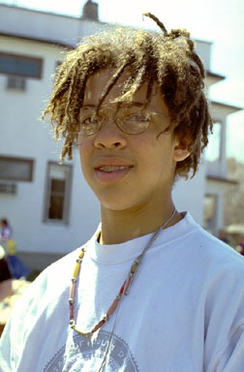

Assessment to
Inform
Instruction
Assessment is the process of gathering evidence of student learning to inform instructional decisions.

Slide 11
Differentiation Elements
STUDENT TRAITS:
Readiness
Interest
Learning Profile
Affect
CLASSROOM ELEMENTS:
Content
Process
Product
Learning Environment
Notes:
Carol Tomlinson added the affective domain (Affect and Learning Environment) in her 2003 book, Fulfilling the Promise of the Differentiated Classroom. She calls them the catalyst for effective differentiation.

Slide 12
WHAT CAN BE ASSESSED?
READINESS
INTEREST
LEARNING
PROFILE
Interest Surveys
Interest Centers
Self-Selection
Areas of Strength
and Weakness
Work Preferences
Self Awareness
Content
Knowledge
Skills
Concepts

Slide 13
What’s the Point?
Learning Profile
Readiness
Interest
Growth
Motivation
Efficiency

Slide 14
Differentiation of instruction is a teacher’s response to a learner’s needs
Guided by general principles of differentiation, such as
Respectful tasks are learning experiences matched to the needs of the student. Tasks that are respectful of the learner honor the differences among students’ readiness levels (appropriately rigorous), areas of interest (engage the learner), and learning profile (attends to learner processing).
Flexible grouping is characterized by the combination of whole group, small group, and independent work. Learners’ readiness, interests, and learning profiles serve as the basis for groups.
Student groups remain flexible because they are responsive to changes in students’ readiness, interests, and learning profile.
Ongoing assessment and adjustment involves the use of pre-, ongoing, and post-assessment data on learner readiness, areas of interest, and learning profile to make adjustments in curriculum and instruction.
With high quality curriculum for all learners as the foundation, teachers can differentiate
Content
Content is the what. Content is often defined by the standards of learning. The content is what students will know, understand, and be able to do as a result of the sequence of teaching and learning.
Process
Process is the how. Process is how students will make sense of the content. The process is made up of the strategies and methods that form the sequence of teaching and learning.
Product
Products are the vehicles by which students demonstrate their knowledge, understanding, and skills. They are the tools teachers use to assess student progress toward the content goals.
Learning Environment
Learning environment is the where. The learning environment is the organization of time, space, and resources for teaching and learning. It is the context in which teaching and learning take place. Developing a strong community of learners is essential to
effective differentiation.
According to student’s
Readiness
The goal of differentiating by learner readiness is growth. Readiness is the point at which knowledge, skills, attitudes, and preparedness for learning converge so that the student is able to meet the demands of an educational experience. Readiness is constantly evolving and changing. If all learners are to progress toward content goals, the varying degrees of readiness for a given objective must be honored. Differentiation according to learner readiness provides an appropriate level of challenge.
Interests
The goal of differentiating by student interest is motivation. If students are going to persist in rigorous content, they must be engaged. Differentiation according to student interest provides guided choices based upon content standards (VBOs/SOLs) where such choices are both appropriate and motivating.
Learning Profile
The goal of differentiating by learner profile is efficiency. Identifying the ways in which students best learn helps organize curriculum and instruction so they learn things in a more efficient manner. A student’s learning profile is the combination of ways in which he/she best processes information.
Adapted by VIRGINIA BEACH CITY PUBLIC SCHOOLS from The Differentiated Classroom by Carol Ann Tomlinson, 1999

Slide 15
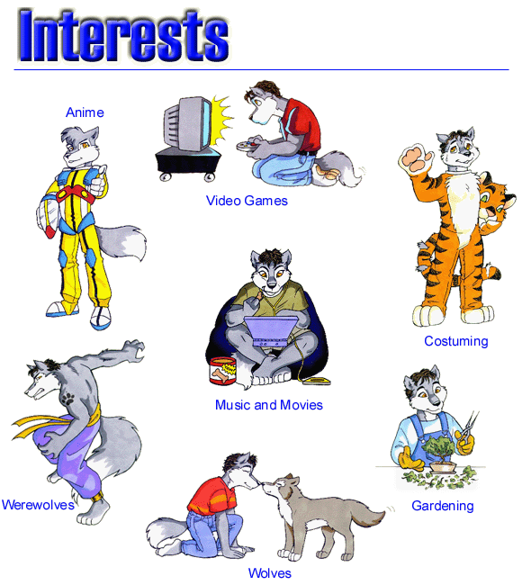
Readiness is a student’s entry point relative to a particular understanding or skill. To help a student to grow, we must begin where the child is. Some children, particularly those who have had early learning opportunities, begin school with well-developed skills and considerable understanding of various topics; other students arrive as true beginners and need basic instruction and additional practice.
  Interest refers to a child’s affinity, curiosity, or passion for a particular topic or skill. The advantage to grouping by interest is that it allows students to attach what they have been learning in class to things that they already find relevant and interesting and appealing in their own lives.
  Learning profile has to do with how students learn. Some are visual learners, auditory learners, or kinesthetic learners. Students vary in the amount of time they need to master a skill or learn a concept.
  How students learn can be shaped by:
  environment social organization physical circumstances
  emotional climate psychological factors

Slide 16
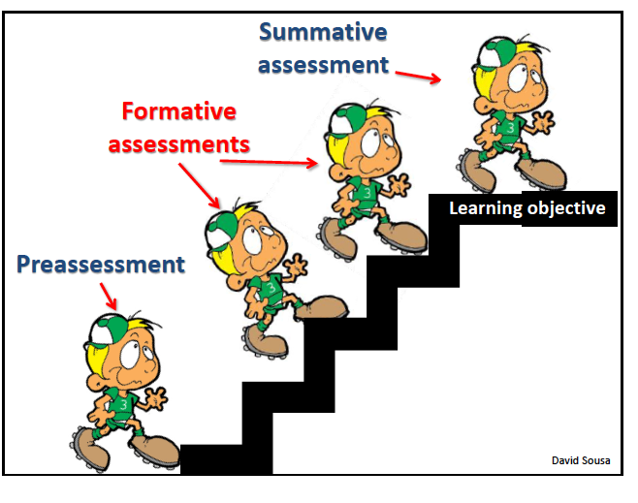
Types of Assessments

Slide 17
On-going Assessment:
A Diagnostic Continuum
Feedback and Goal Setting
Preassessment
(Finding Out)
Formative Assessment
(Keeping Track & Checking -up)
Summative Assessment
(Making sure)
Pre-test
Graphing for Greatness
Inventory
KWL
Checklist
Observation
Self-evaluation
Questioning
Conference Exit Card
Peer evaluation Portfolio Check
3-minute pause Quiz
Observation Journal Entry
Talkaround Self-evaluation
Questioning
Unit Test
Performance Task
Product/Exhibit
Demonstration
Portfolio Review

Slide 18
Preassessment Is...
Any method, strategy or process used to determine a
student’s current level of readiness or interest in order to
plan for appropriate instruction.
  provides data to determine options for students
  helps determine differences before planning
  helps teacher design activities that are respectful and challenging
  allows teachers to meet students where they are
  identifies starting point for instruction
  identifies learning gaps
  makes efficient use of instructional time

Slide 19
Formative Assessment Is...
A process of accumulating information about a student’s
progress to help make instructional decisions that will
improve his/her understandings and achievement levels.
  depicts student’s life as a learner
  used to make instructional adjustments
  alerts the teacher about student misconceptions
  “early warning signal”
  allows students to build on previous experiences
  provides regular feedback
  provides evidence of progress
  aligns with instructional/curricular outcomes

Slide 20
Summative Assessment Is...
A means to determine a student’s mastery and
understanding of information, skills, concepts, or
processes.
  should reflect formative assessments that precede it
  should match material taught
  may determine student’s exit achievement
  may be tied to a final decision, grade or report
  should align with instructional/curricular outcomes
  may be a form of alternative assessment

Slide 21
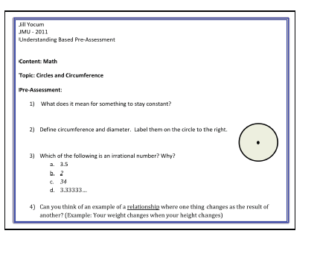

Slide 22
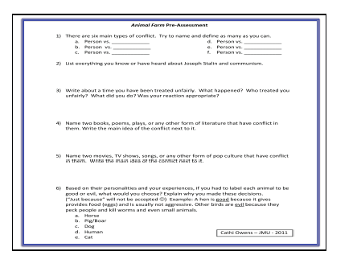

Slide 23
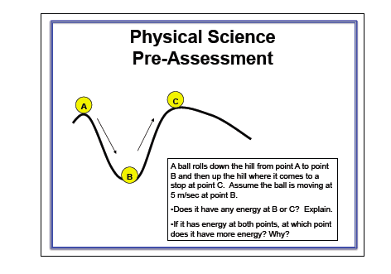

Slide 24
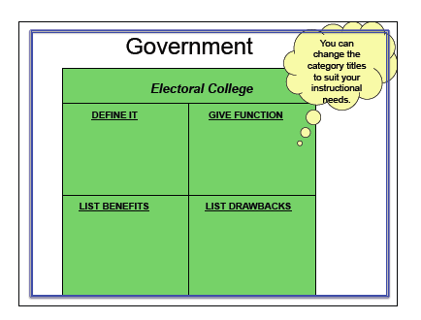

Slide 25
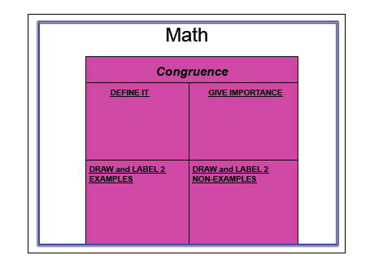

Slide 26
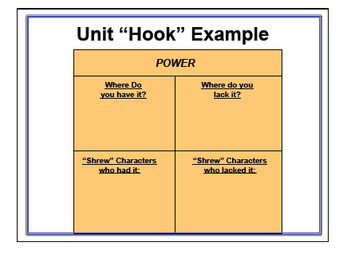

Slide 27
Directions: Complete the chart to show what you know about ________.
Write as much as you can.
Definition
Information
Fractions
Examples
Non-Examples
Useful for pre-assessment & formative assessment of readiness in many grades & subjects

Slide 28
Place Mat Assessment
Place a large piece of butcher paper or other large sheet of paper in the center of a group of students. Draw a “Place Mat” figure in the center of the paper. Have as many sub-divisions / squares depending on the number of students in the group that are to use the place mat. Students are then asked to write as much as they know about the center topic.
K-2: Compare and sort common materials found in your home?
8: How energy is transferred in my home?

Slide 29


Telling Time
Make a list of the 1st grade children and what you think the data tells you about their knowledge of telling time and clocks.
Think about the children whose clocks you reviewed. Who needs what?
How will you plan for their instruction?

Slide 30
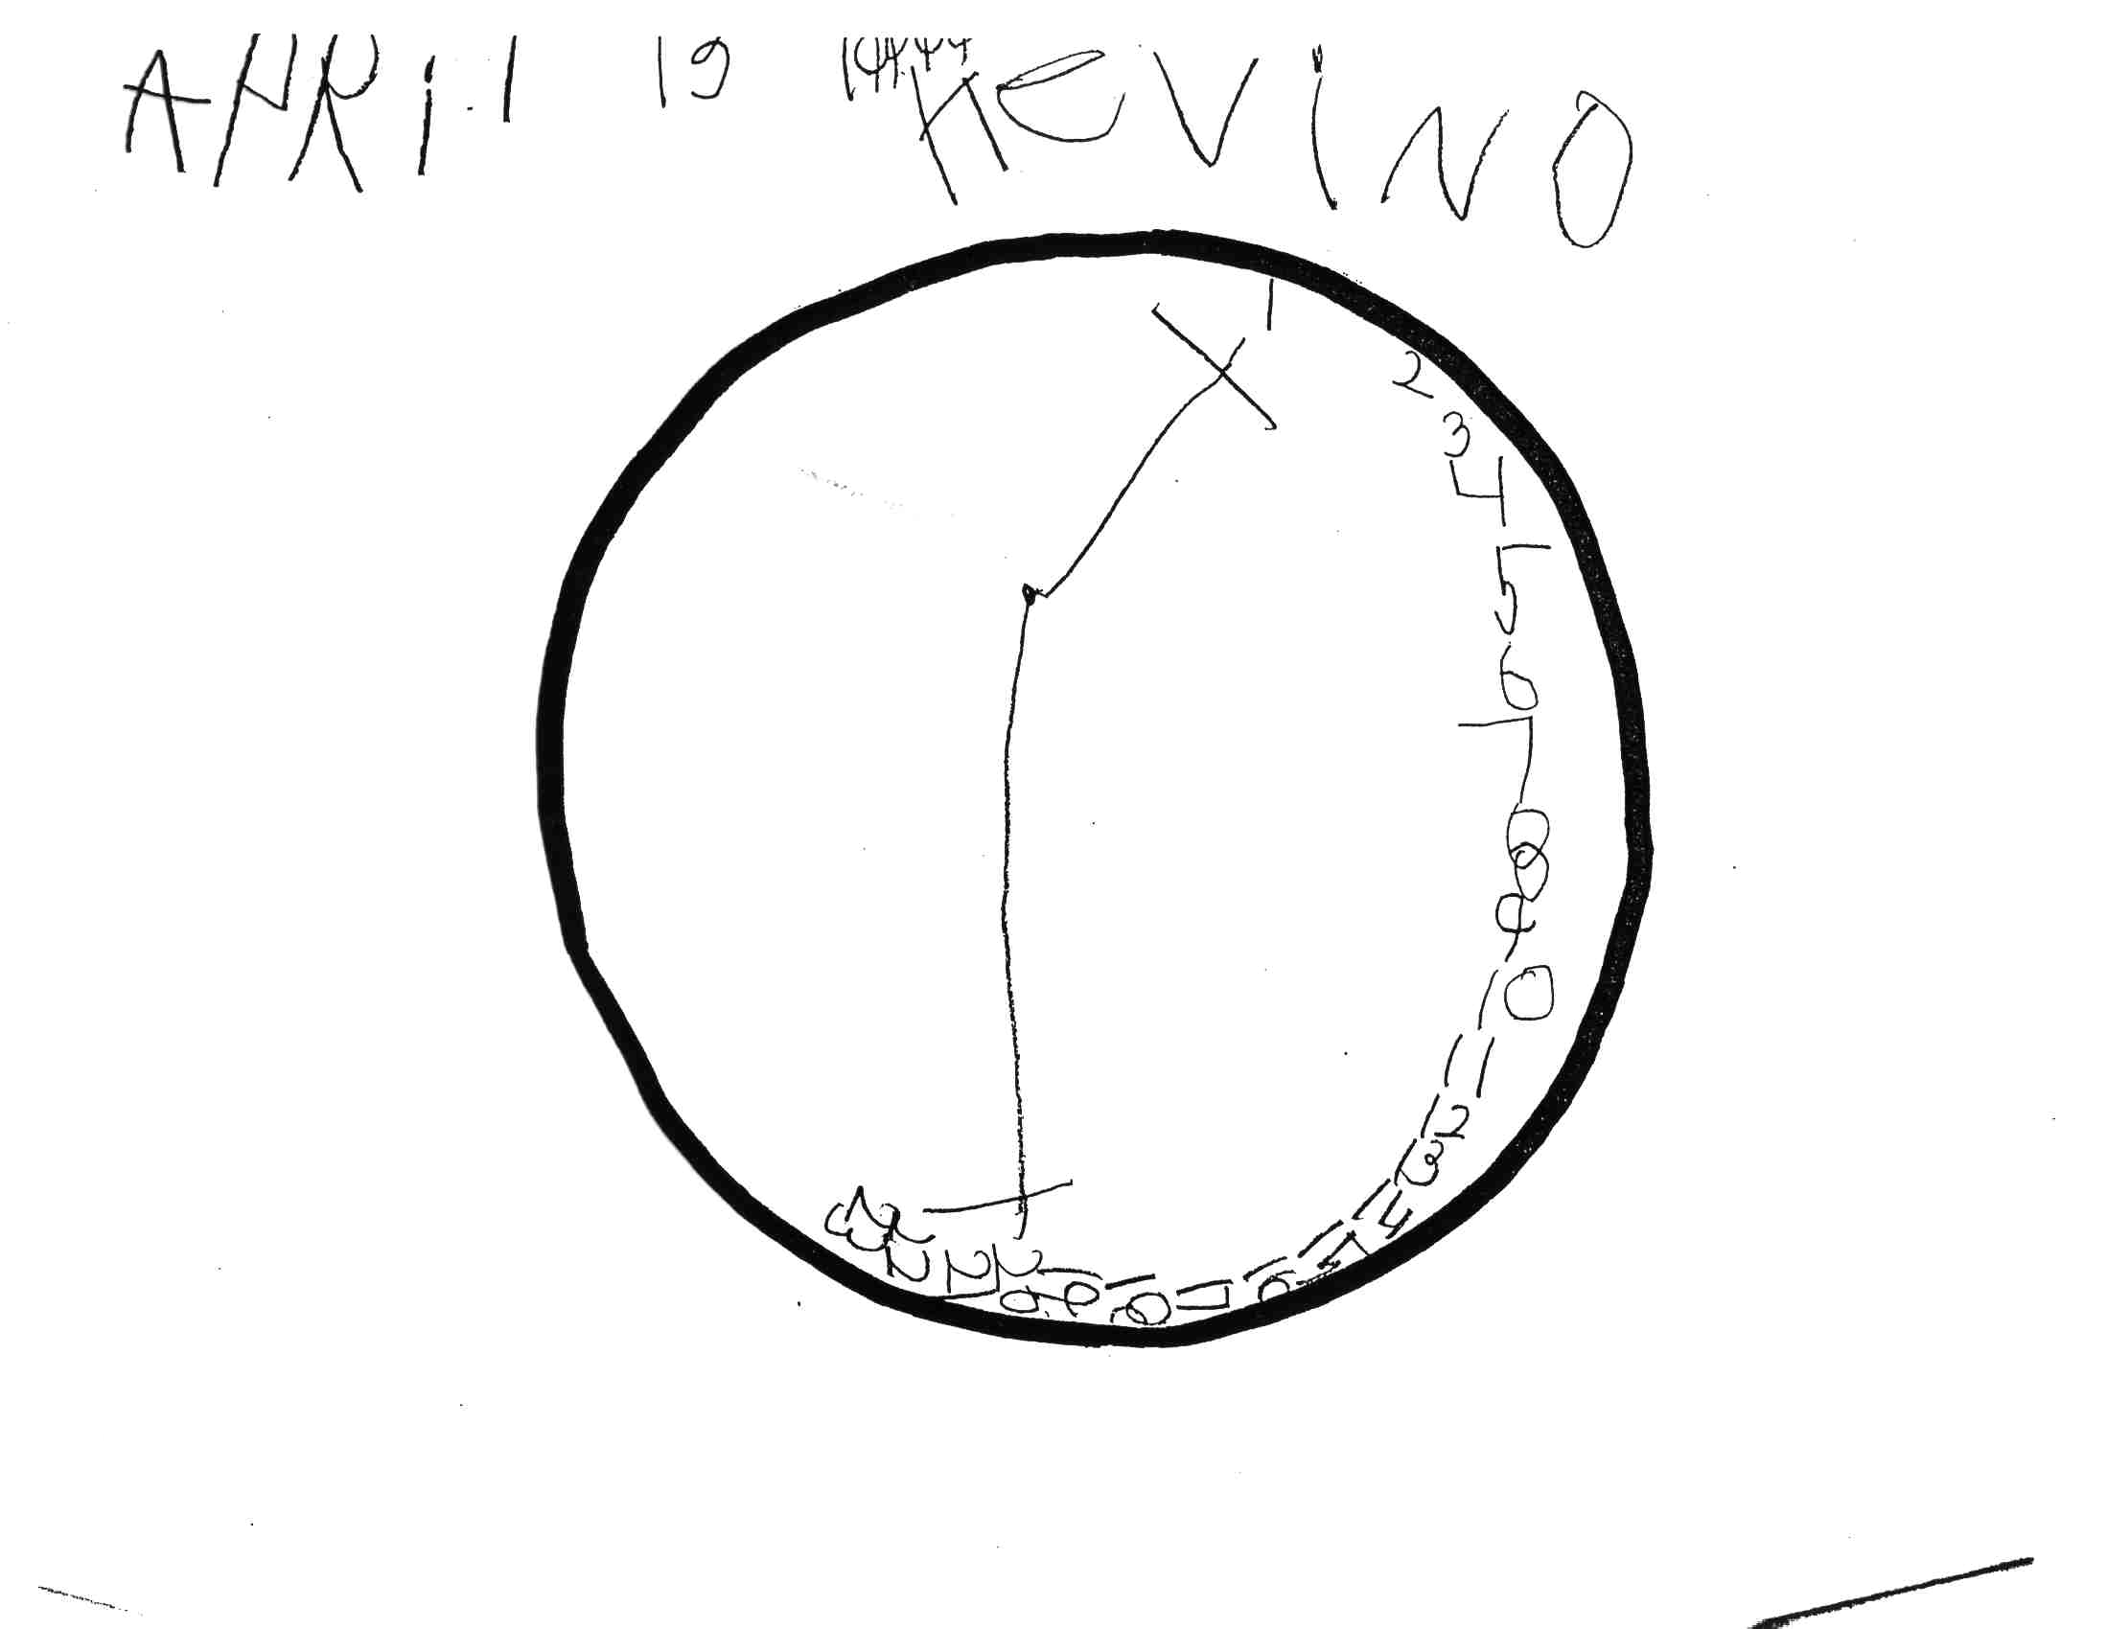

Slide 31
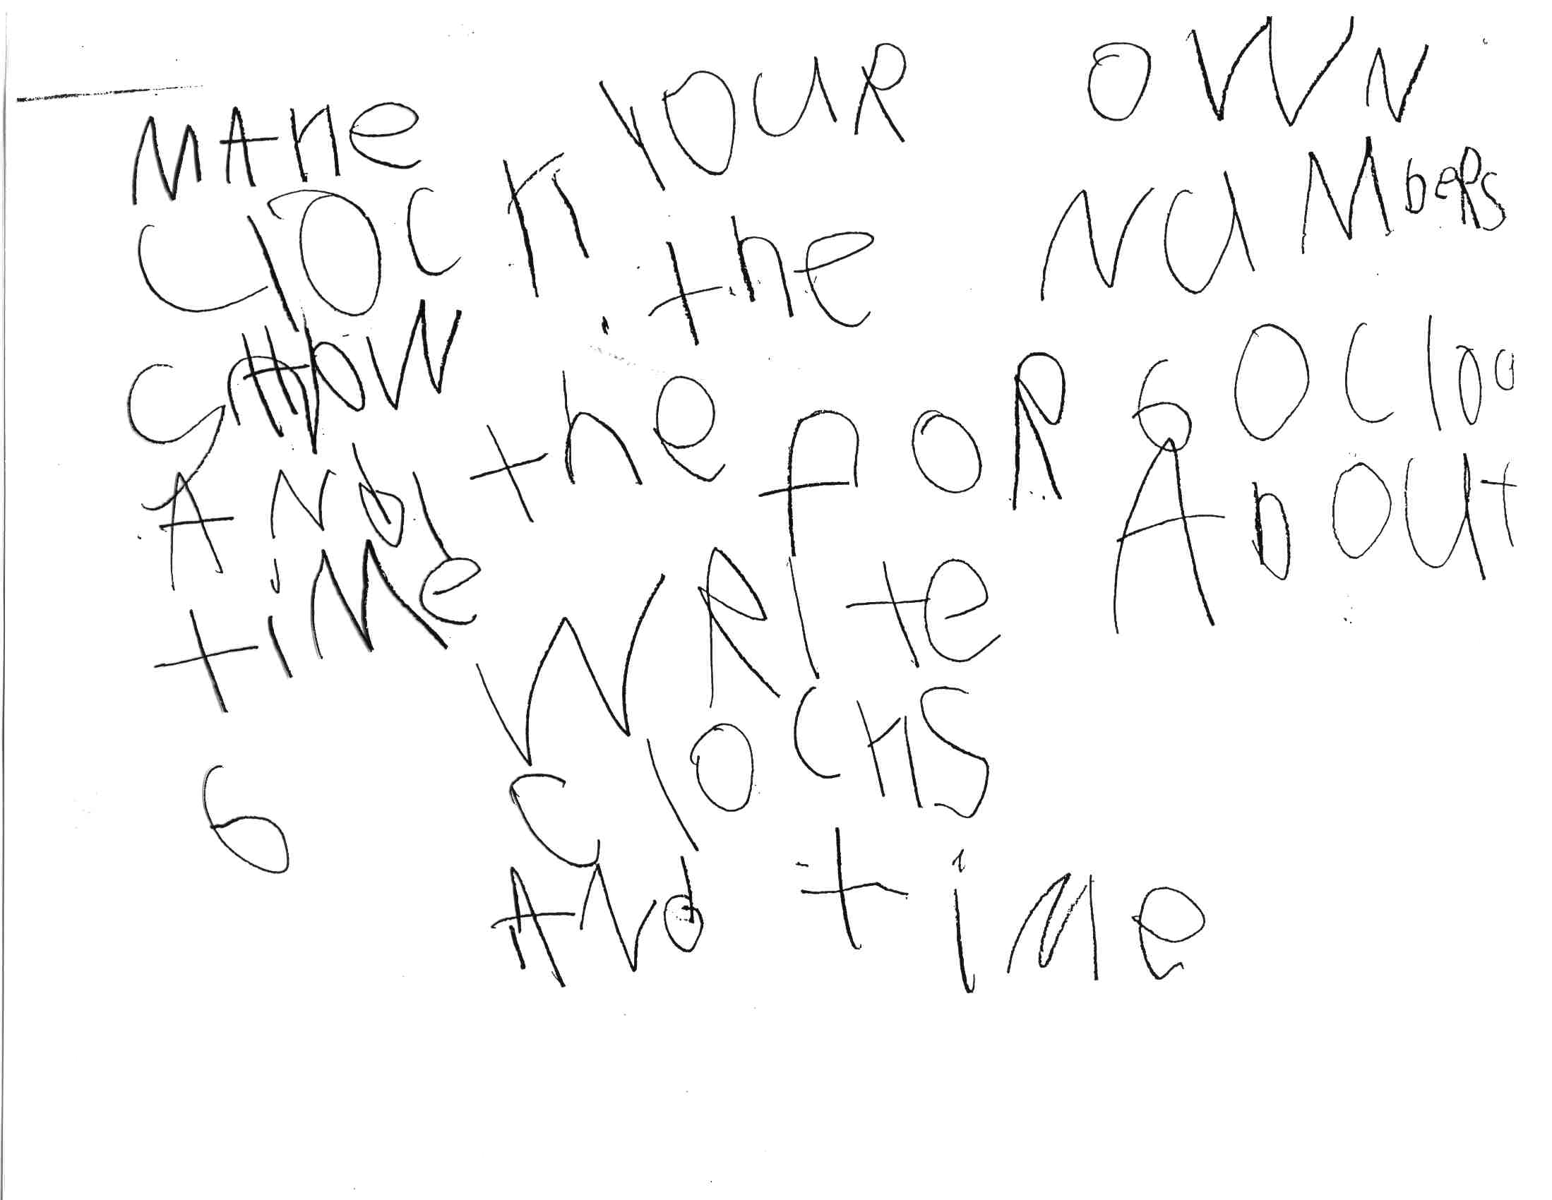

Slide 32
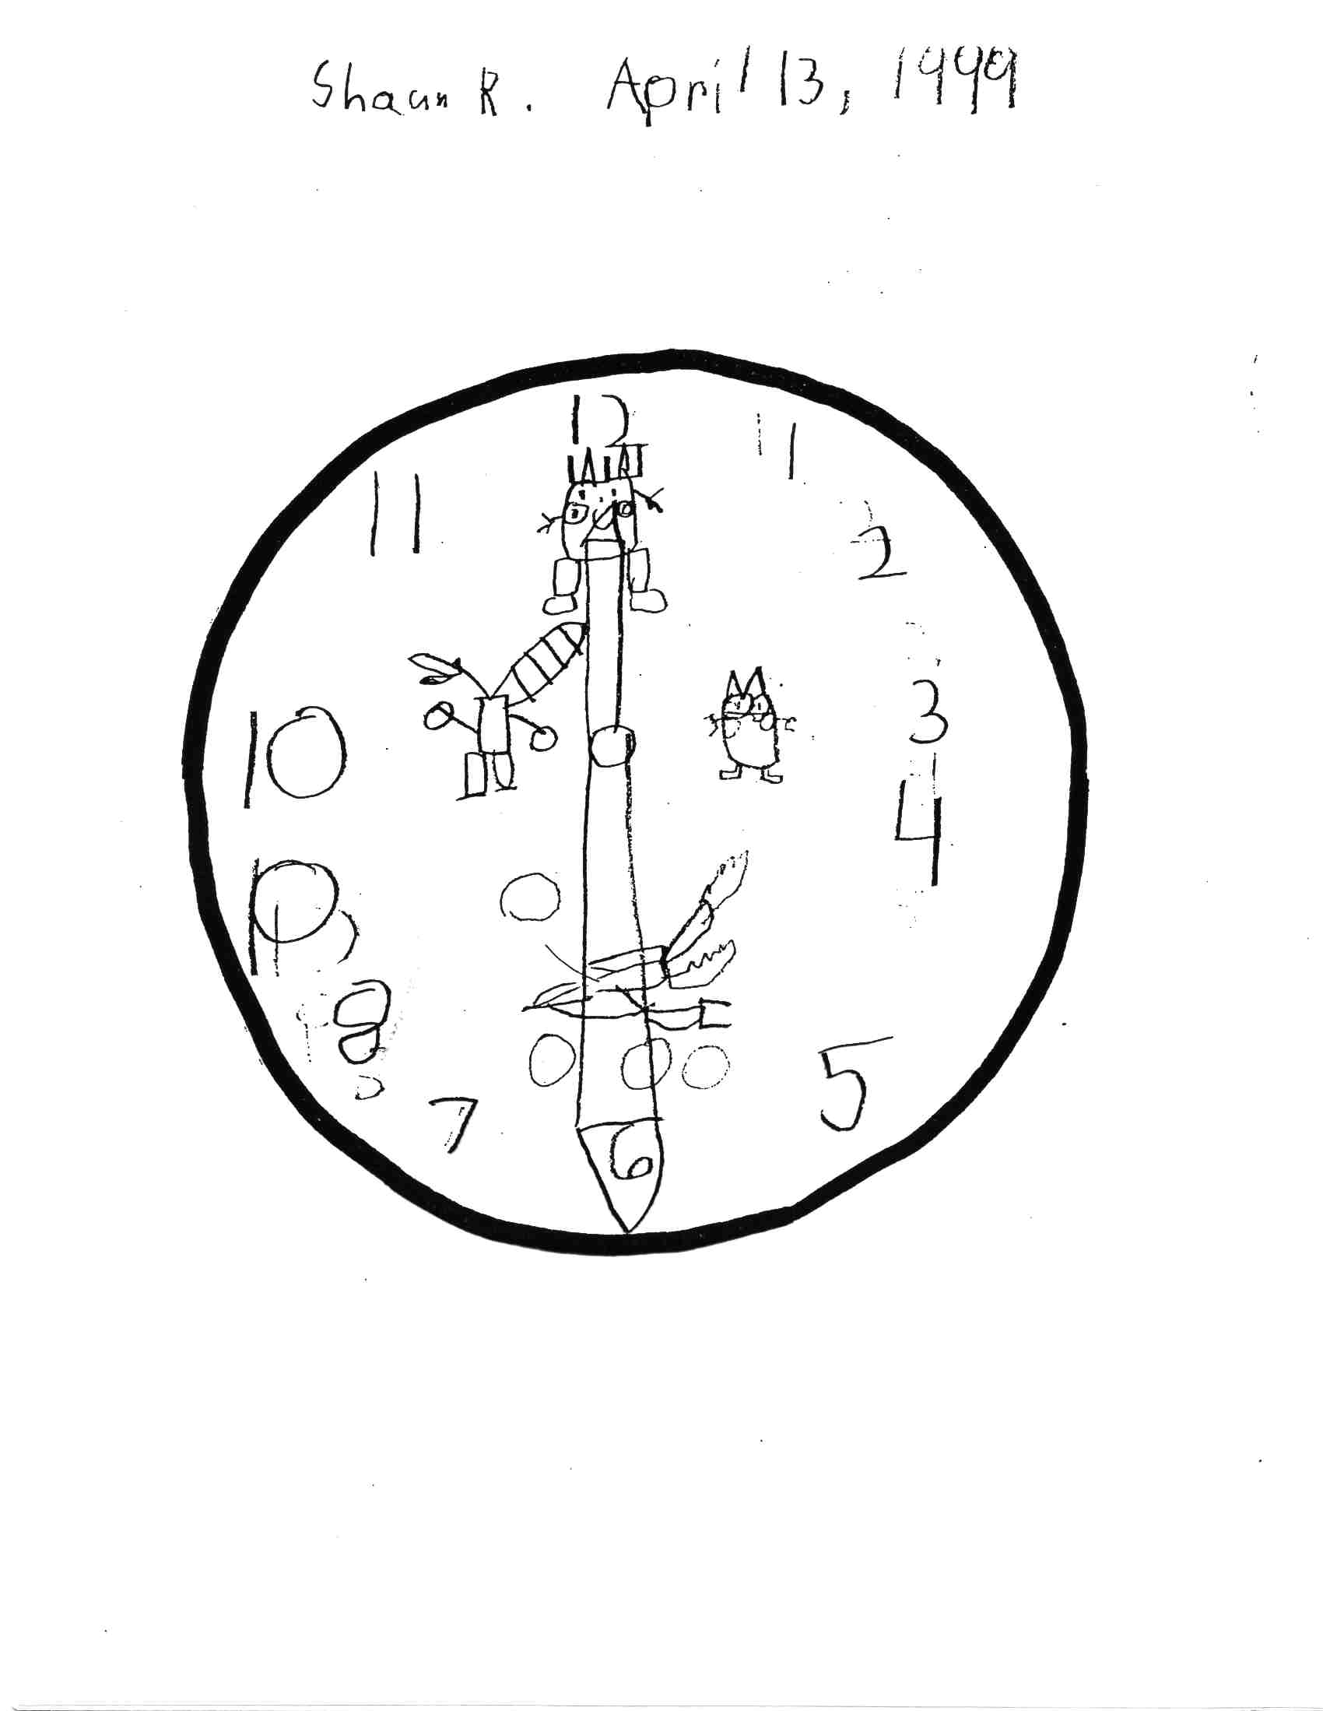

Slide 33
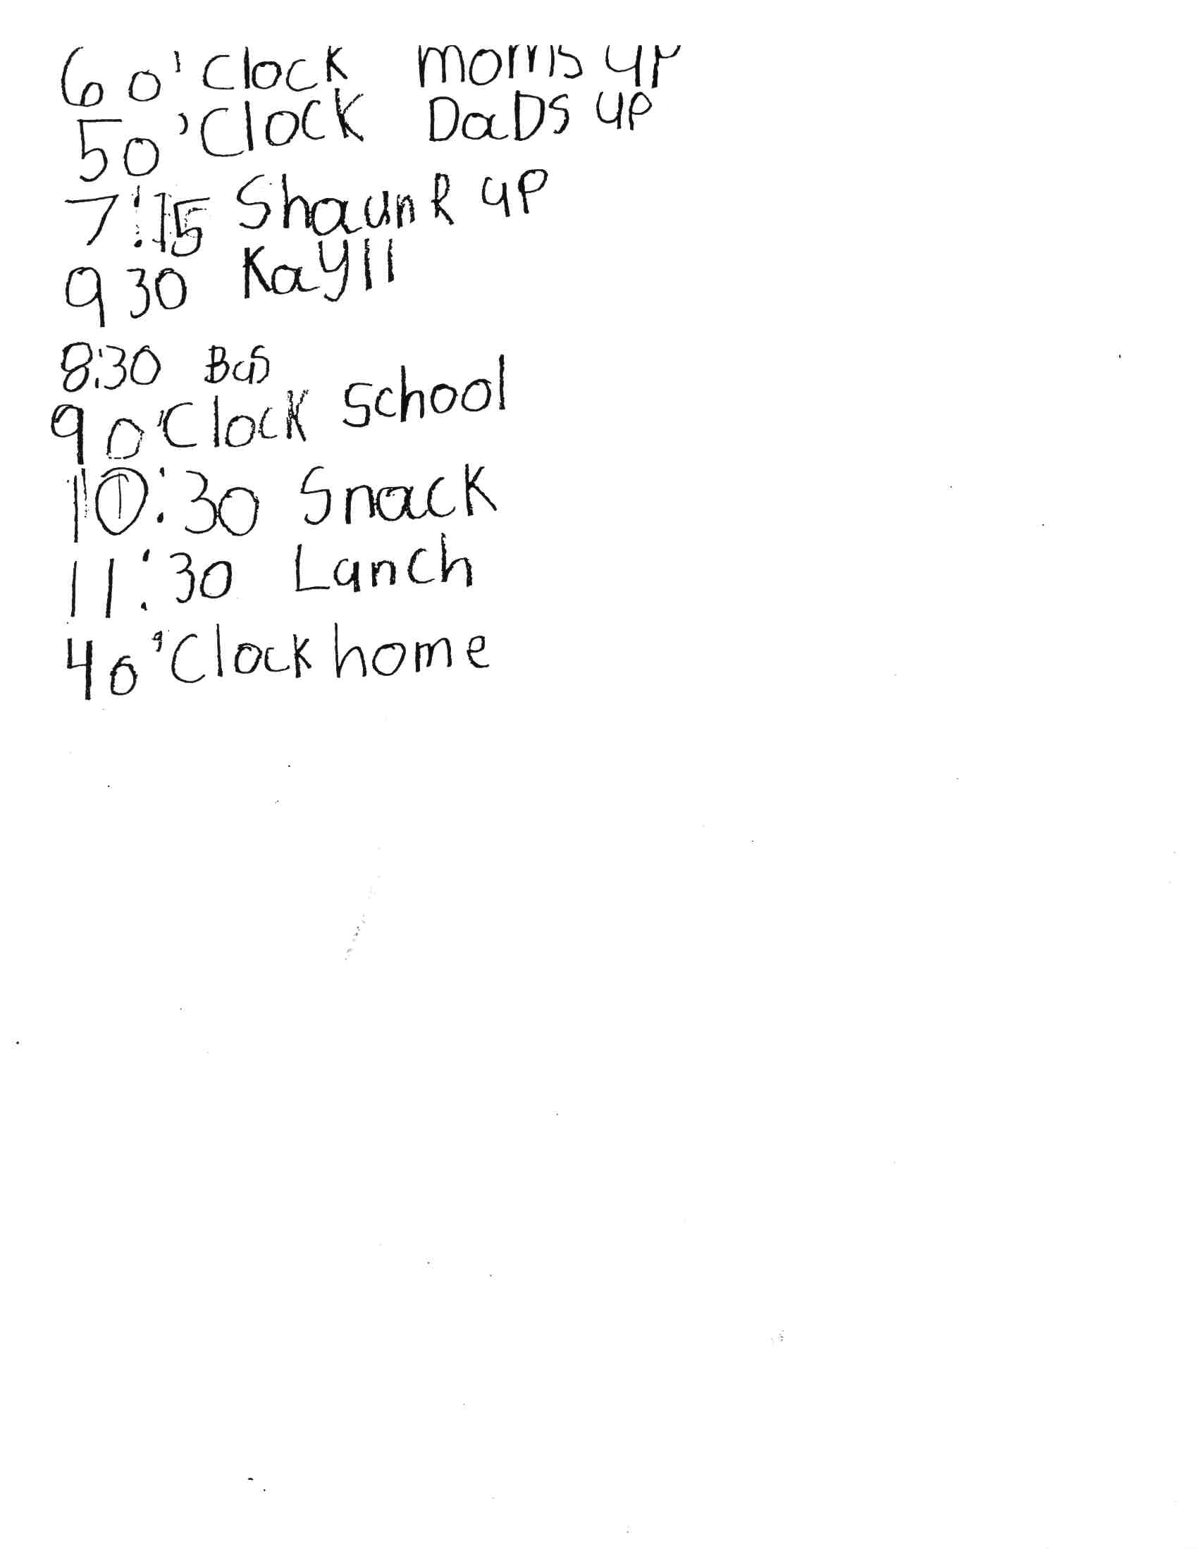

Slide 34
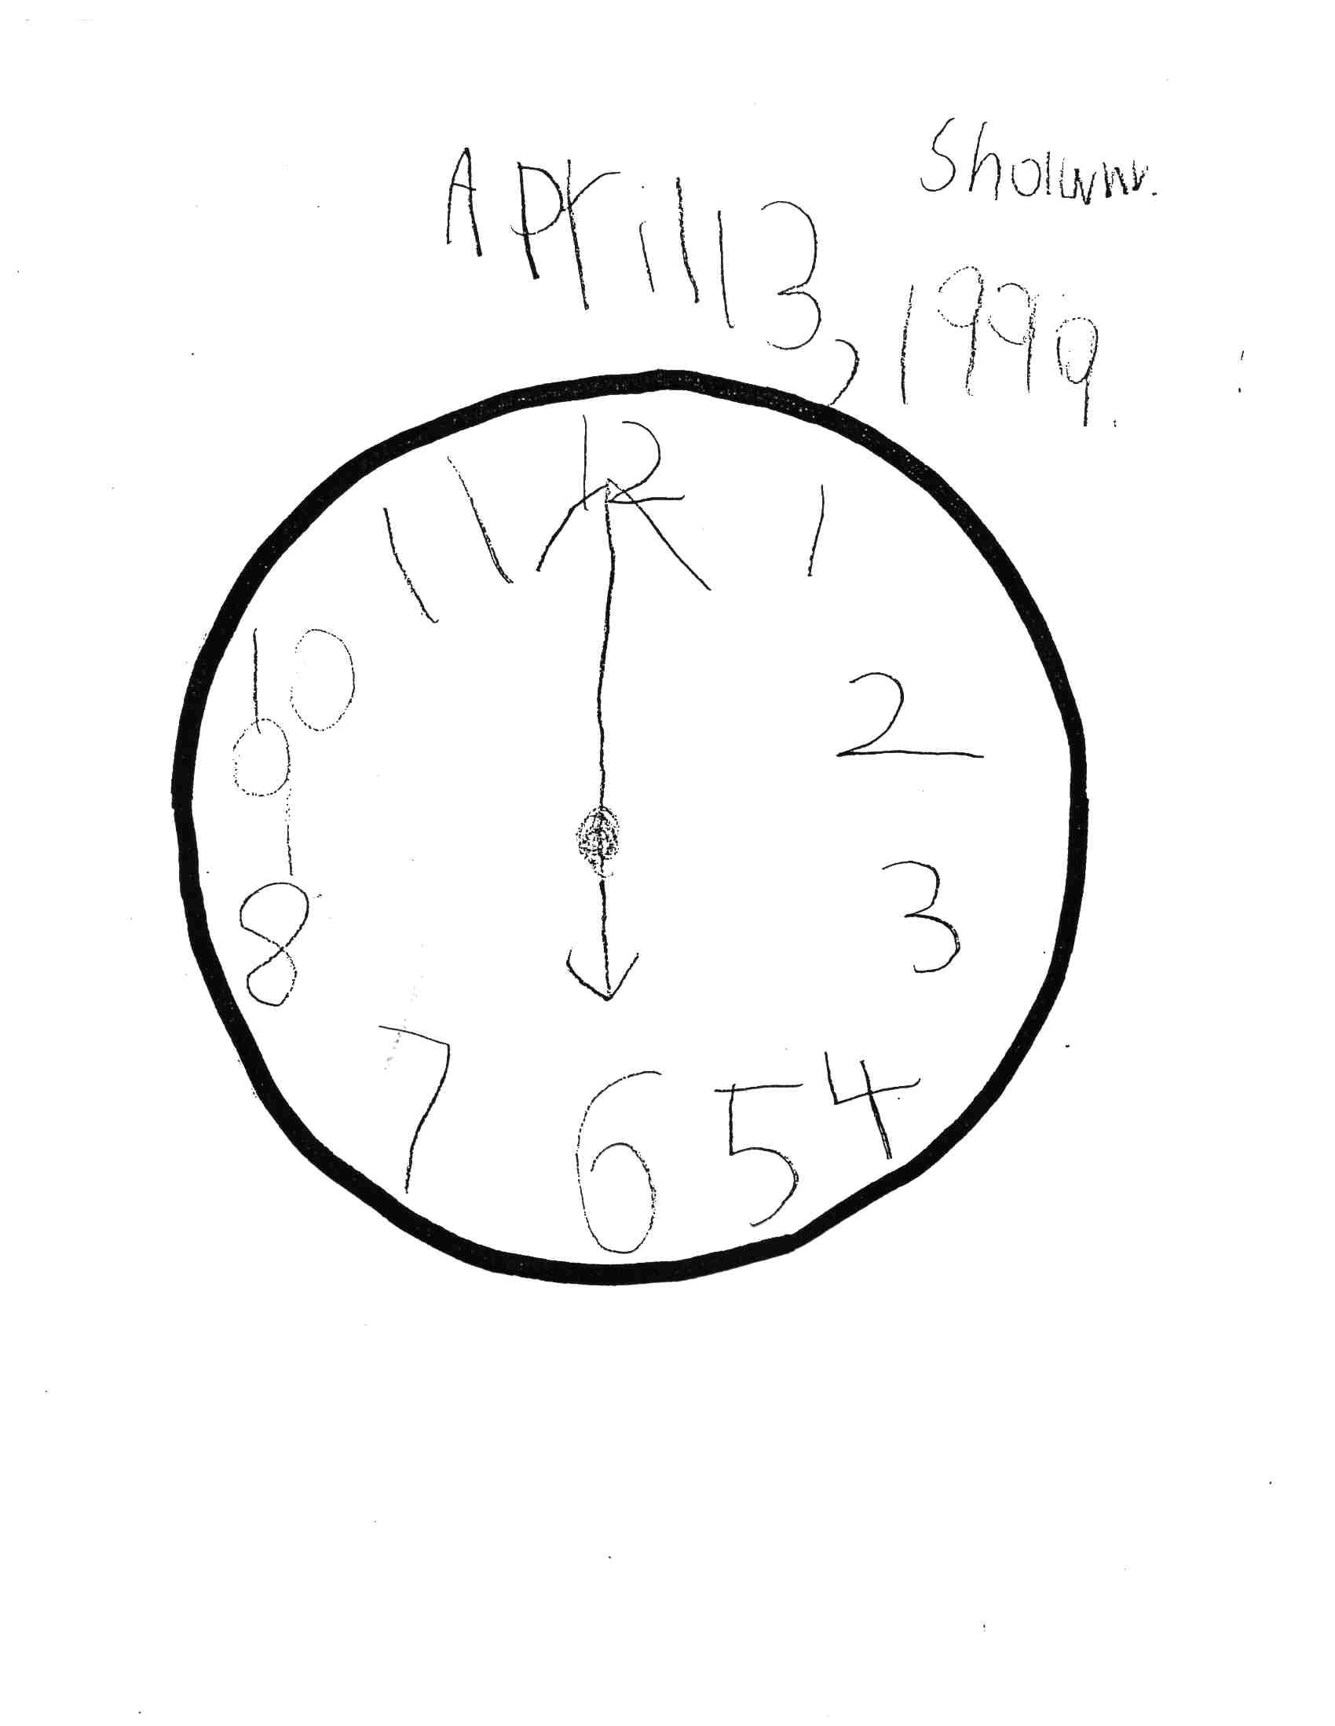

Slide 35
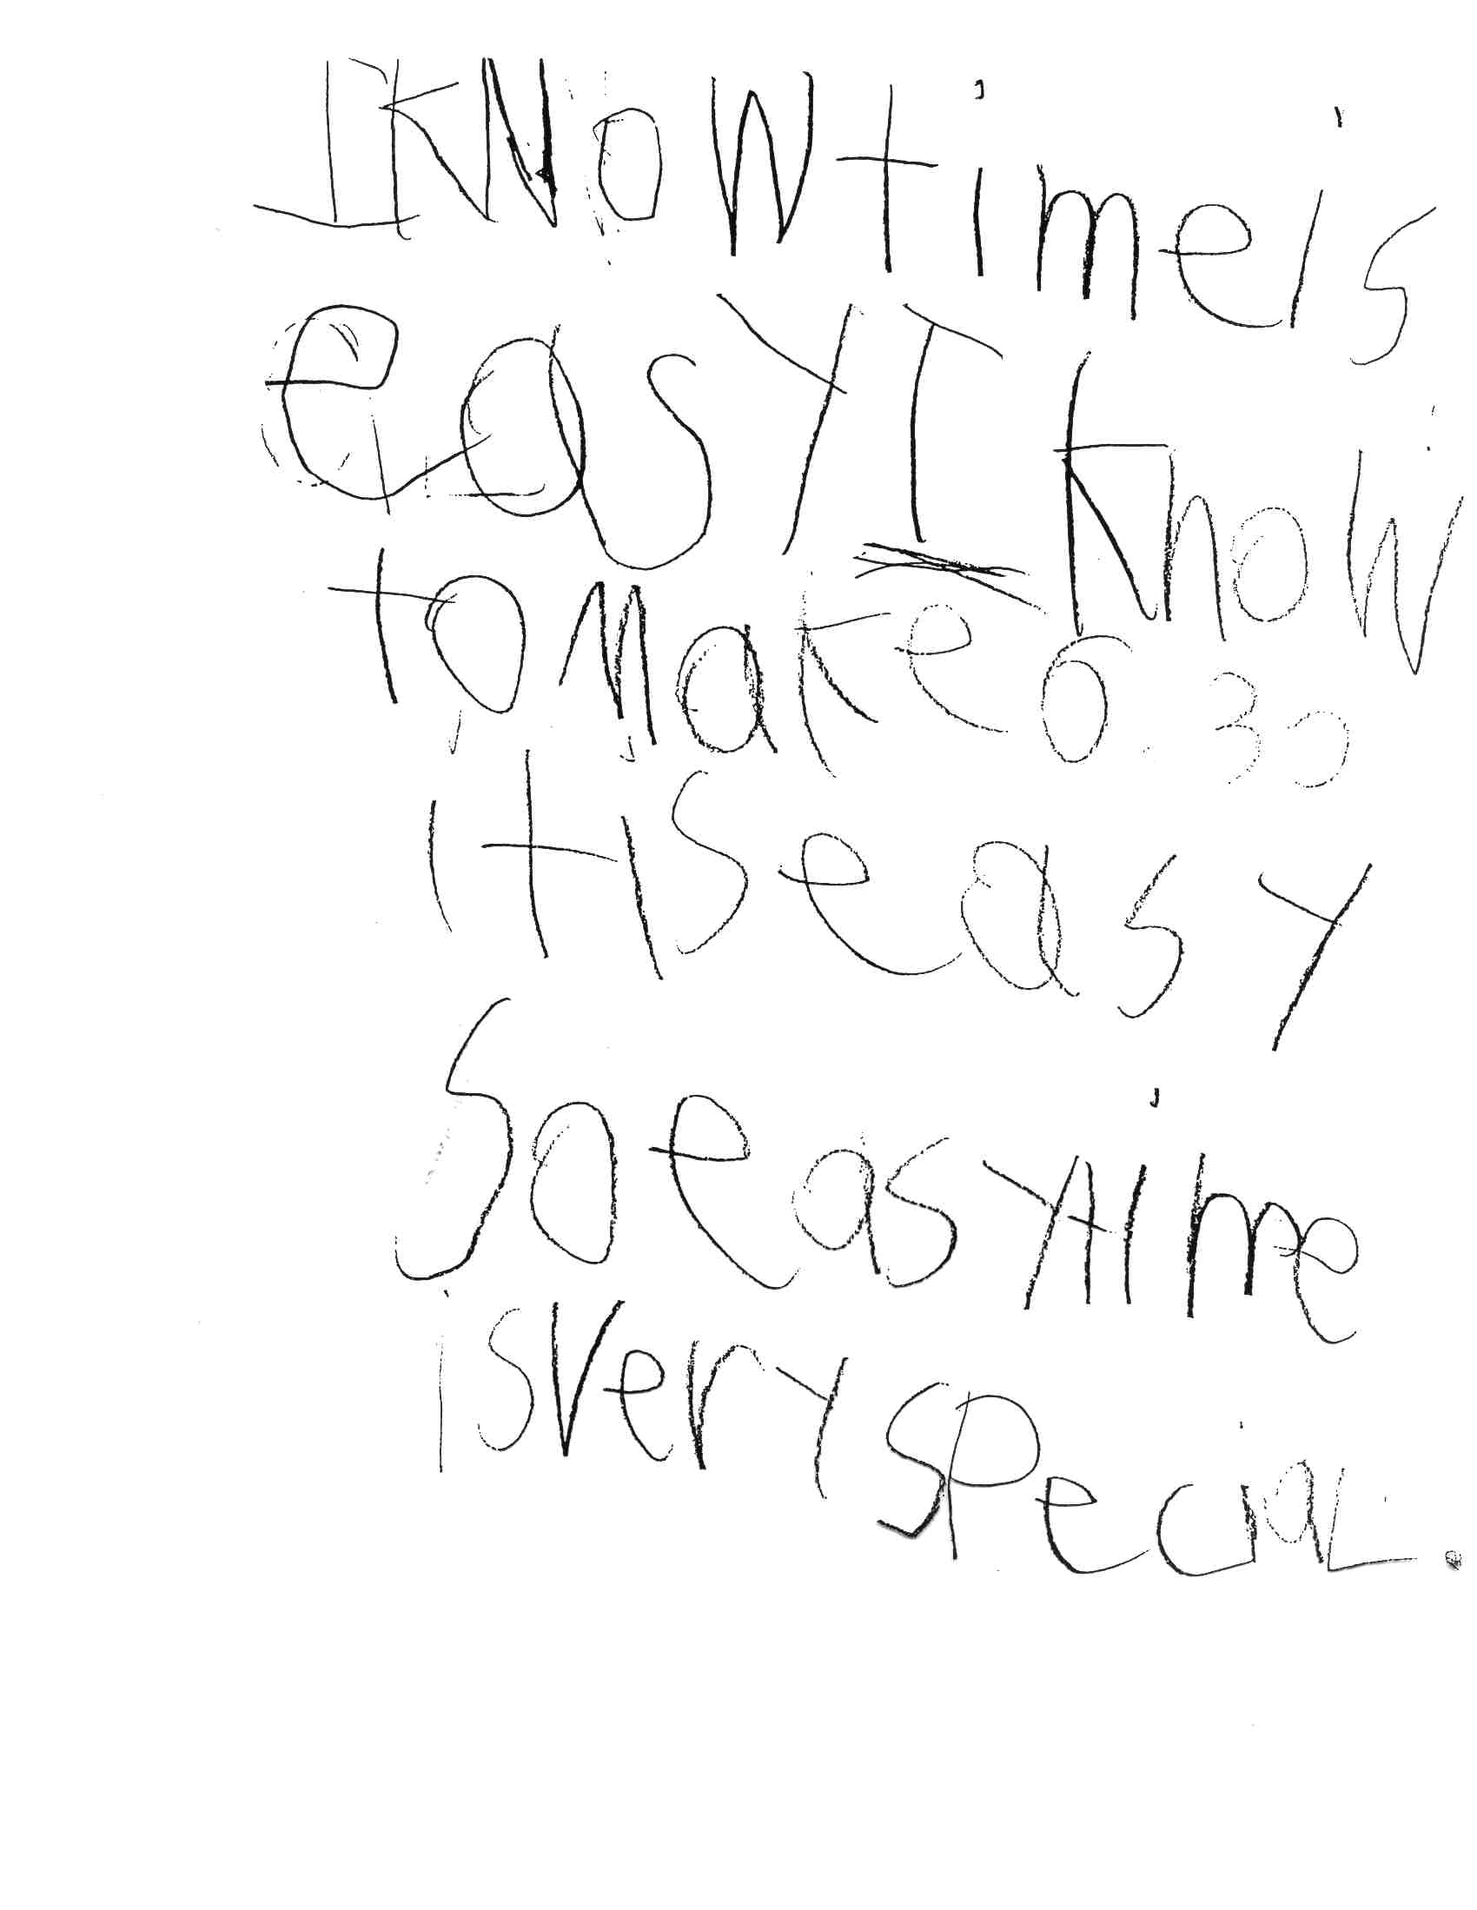

Slide 36
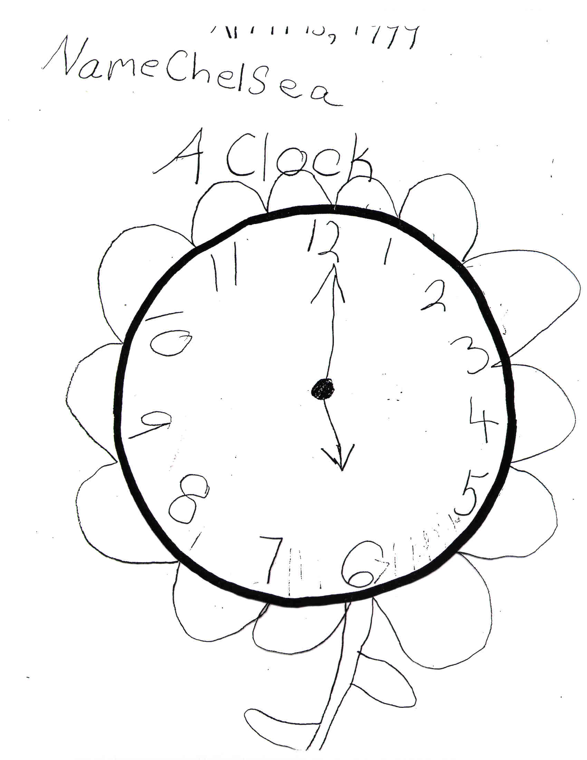

Slide 37
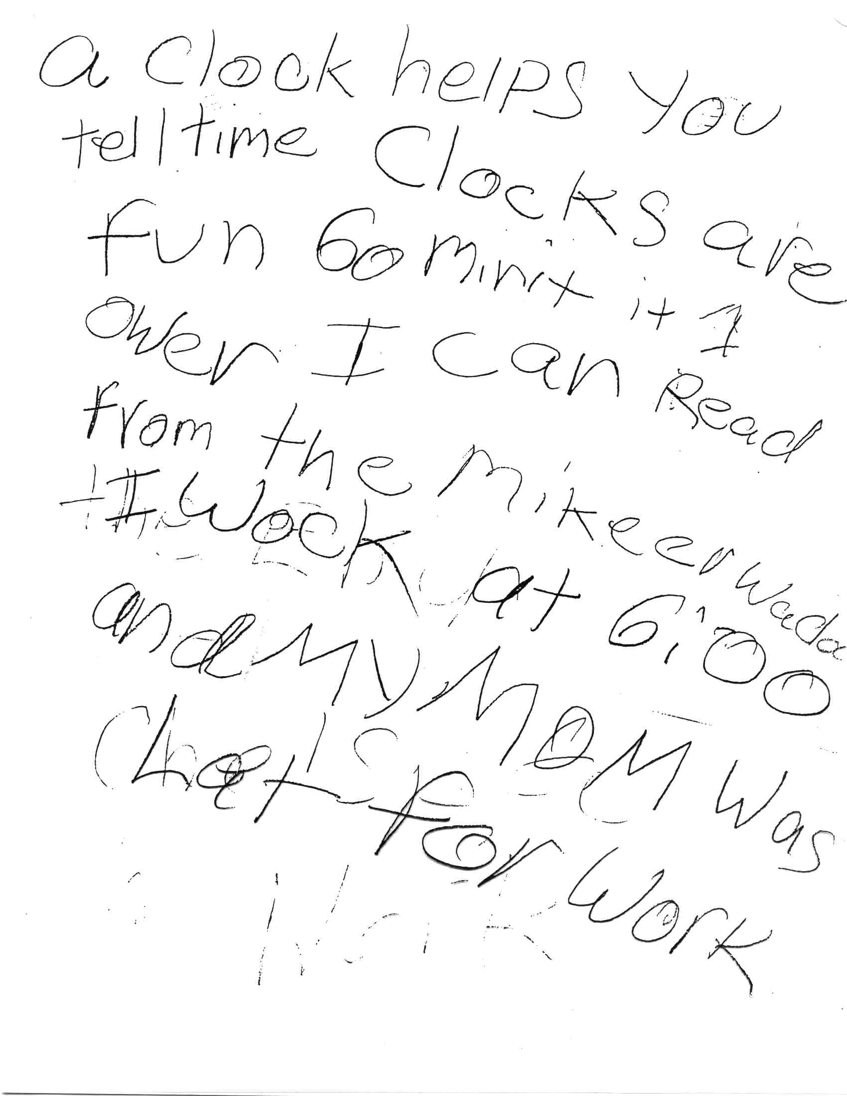

Slide 38
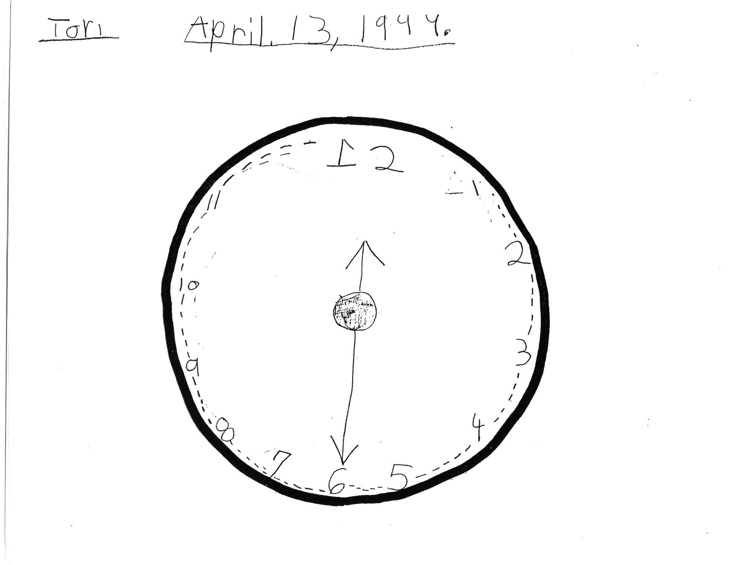

Slide 39
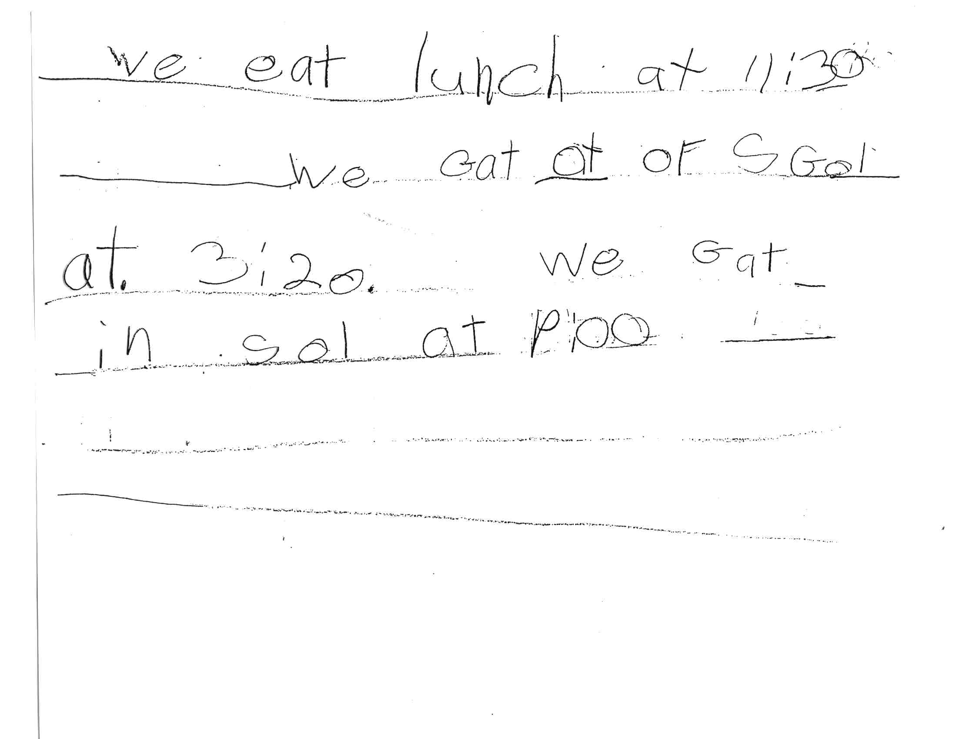

Slide 40
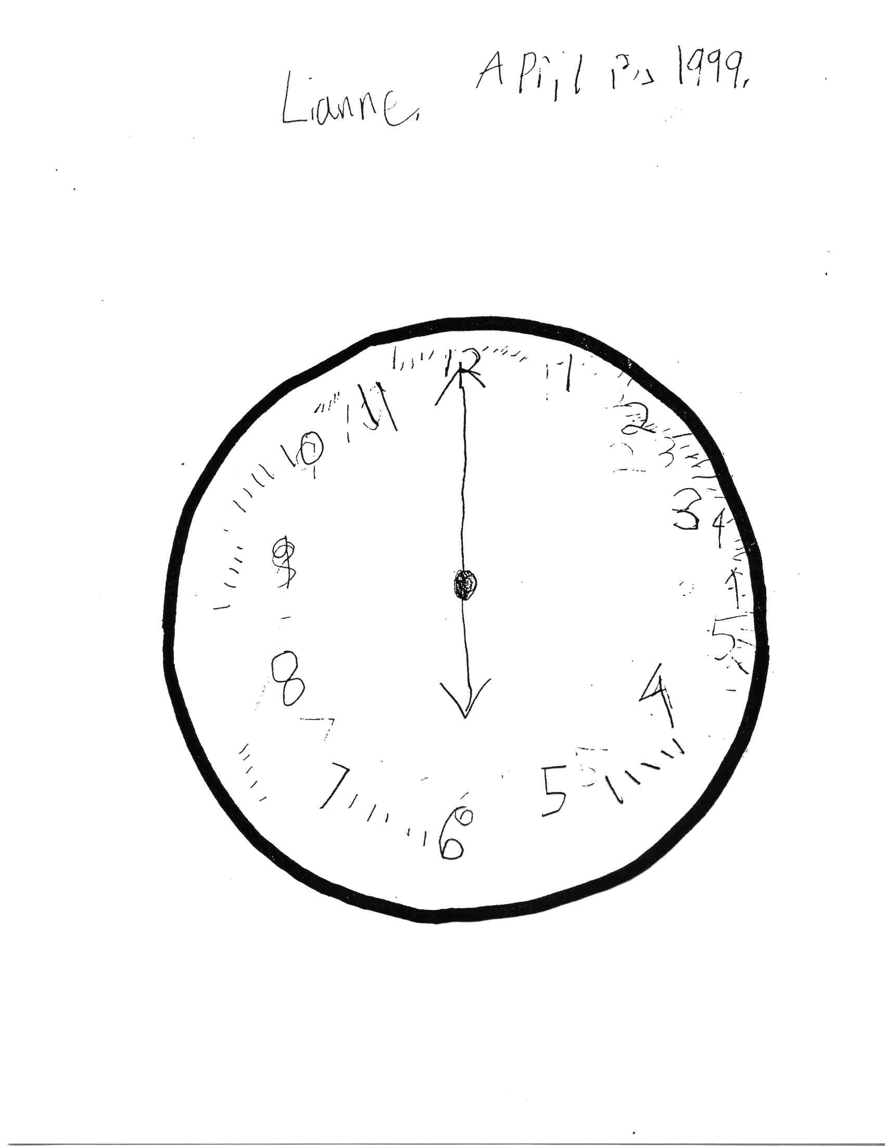

Slide 41
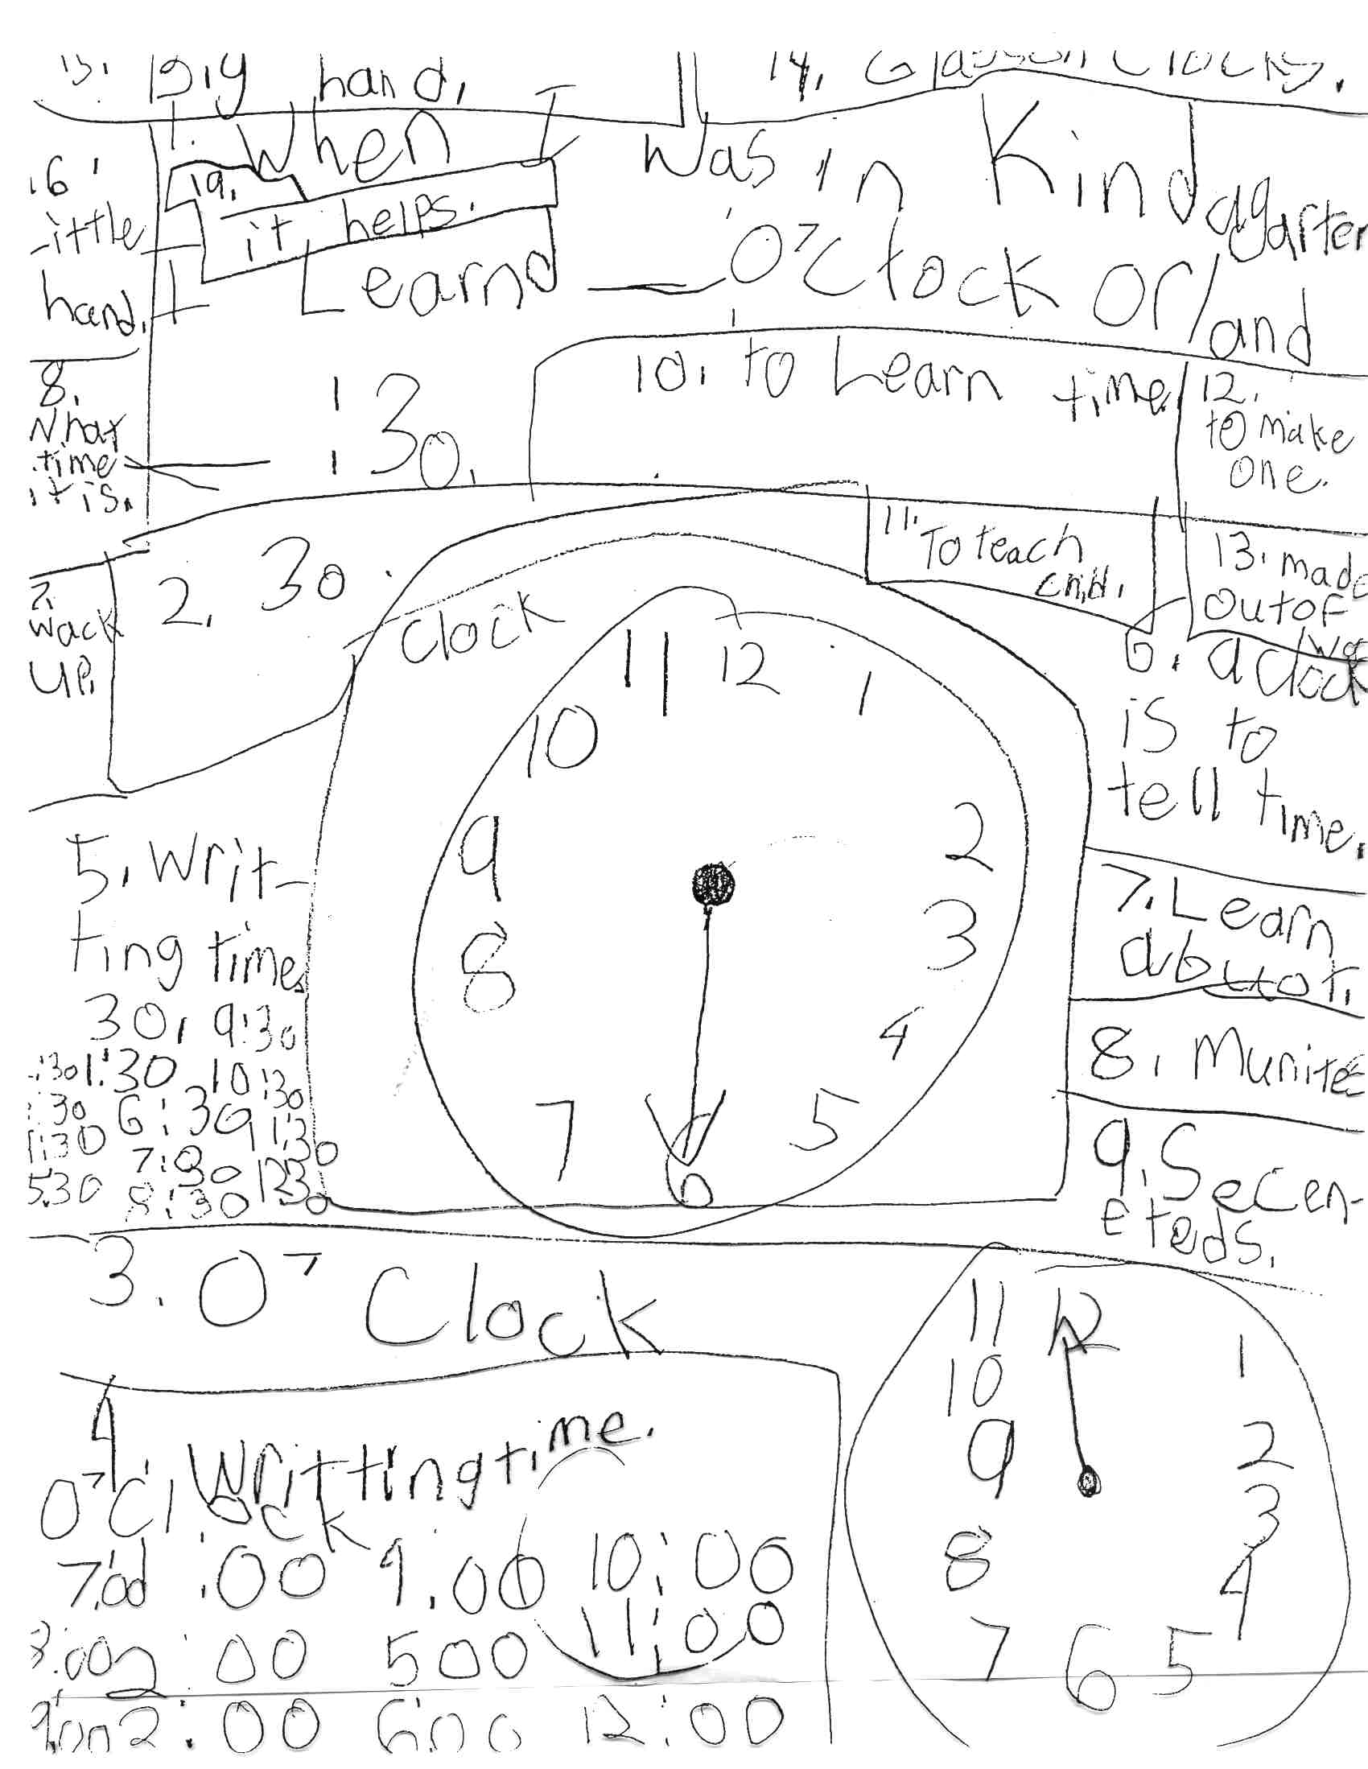

Slide 42
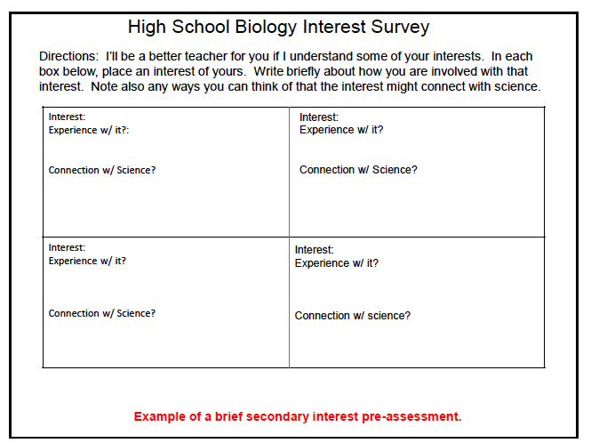

Slide 43
What Do You Want to Learn About Rome?
Name: _______________________
These are some of the topics we will be studying in our unit on Ancient Rome.
We want to know what you want to learn about. Number your choices from 1
to 8. Make sure that 1 is your favorite and 8 is your least favorite.
____ geography
____ government (laws)
____ agriculture (foods they grew)
____ architecture (buildings)
____ music and art
____ religion and
____ sports
____ roles of men, women, and children
What Can You Tell Us About Rome?
1. What country is Rome in? ______________
2. What does the word civilization mean?__________________________ ______________________________________________________
______________________________________________________.
3. Can you give us some examples of different civilizations? ____________
______________________________________________________.
4. Can you name any famous Roman people? ________________________
______________________________________________________.
5. Many things in our country and culture came from the Romans. Can you think of any? ___________________________________________
______________________________________________________
______________________________________________________.

Slide 44
How Do You Like to Learn?
I study best when it is quiet. Yes No
I am able to ignore the noise of other people talking while I am working. Yes No
I like to work at a table or desk. Yes No
I like to work on the floor. Yes No
I work hard by myself. Yes No
I work hard for my parents or teacher. Yes No
I will work on an assignment until it is completed, no matter what. Yes No
Sometimes I get frustrated with my work and do not finish it. Yes No
When my teacher gives an assignment, I like to have exact steps on how to complete it. Yes No
When my teacher gives an assignment, I like to create my own steps on how to complete it. Yes No
I like to work by myself. Yes No
I like to work in pairs or in groups. Yes No
I like to have unlimited amount of time to work on an assignment. Yes No
I like to have a certain amount of time to work on an assignment. Yes No
I like to learn by moving and doing. Yes No
I like to learn while sitting at my desk. Yes No

Slide 45
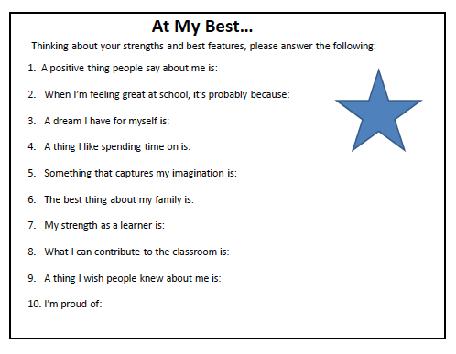

Slide 46
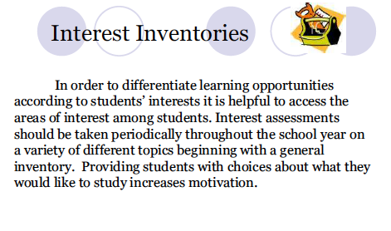

Slide 47
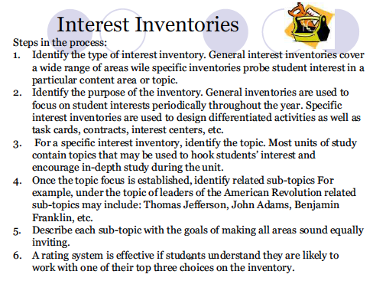

Slide 48
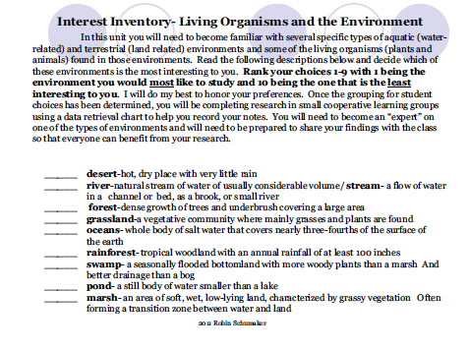

Slide 49
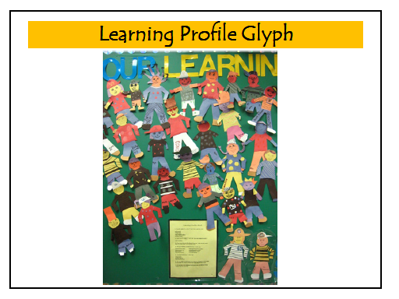

Slide 50
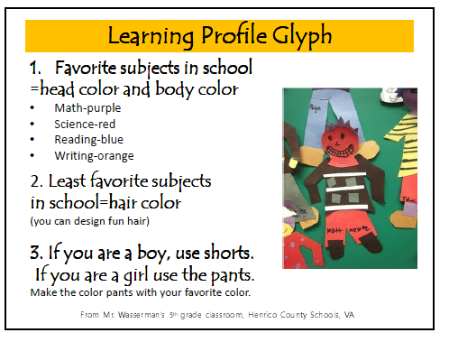

Slide 51
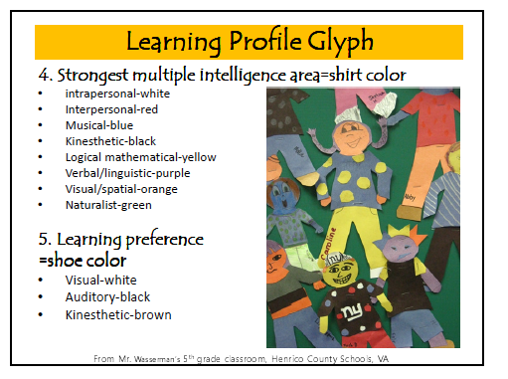

Slide 52
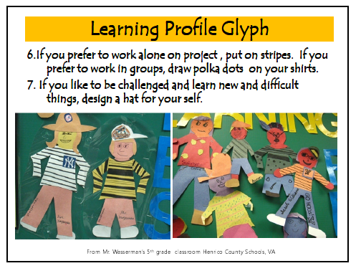

Slide 53
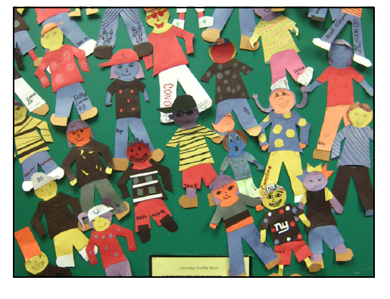

Slide 54
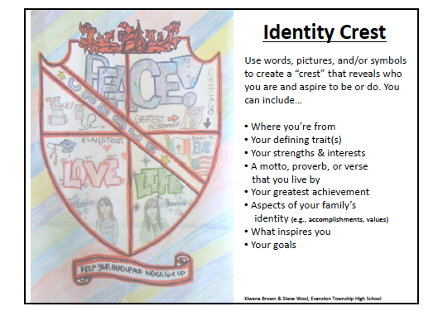

Slide 55
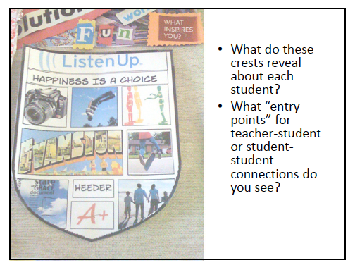

Slide 56
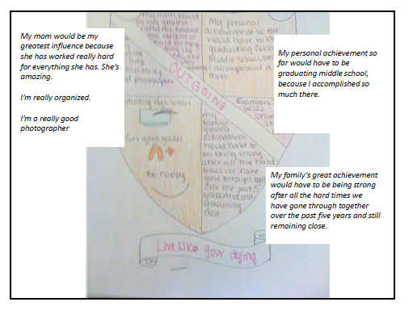

Slide 57
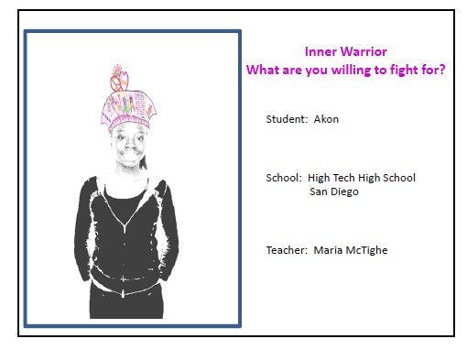

Slide 58
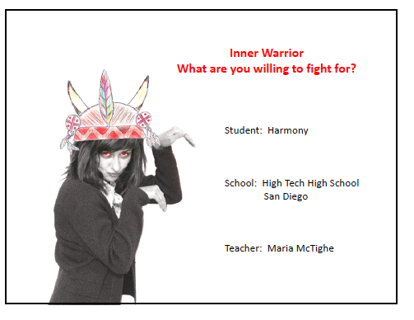

Slide 59
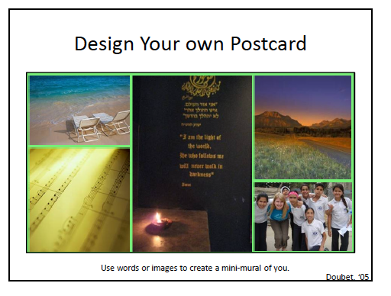

Slide 60
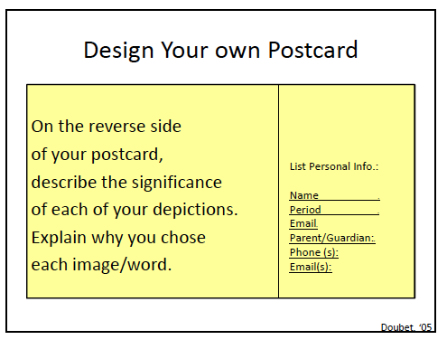

Slide 61
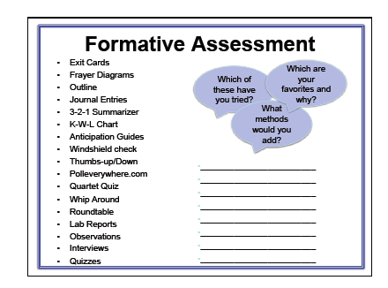

Slide 62
Exit Cards: Algebra
Name:
Draw a graph & label the “x” and “y” axes
Graph a line with the endpoints (3,5) (7,2)
Graph a line with the endpoints (-3,-5) (7,2)
Provide two ways of writing the equation for a line

Slide 63
Exit Cards: Science
Name:
Draw the earth’s orbit around the sun.
Briefly explain what causes the seasons. Use illustrations if necessary.
How have your opinions about this topic changed? What questions you still have?

Slide 64
3-2-1 Card
Name:
3 things I learned from the addition lab…
2 questions I still have about addition…
1 thing way I see addition working in the world around me….

Slide 65
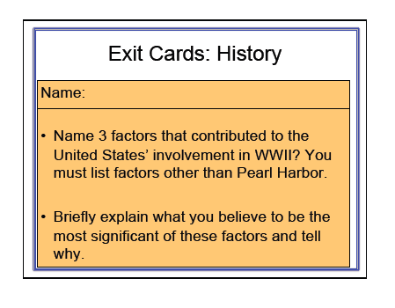

Slide 66
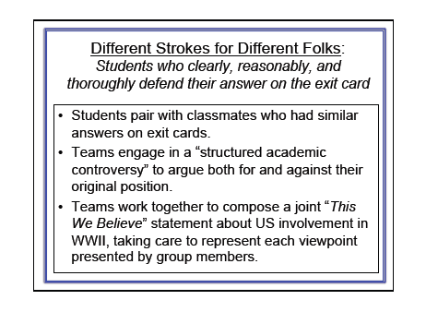

Slide 67
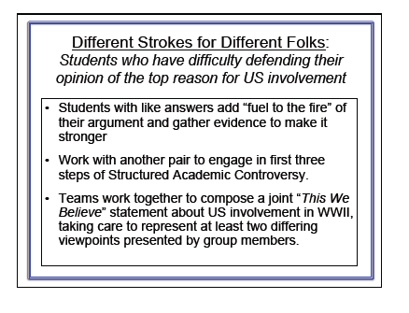

Slide 68
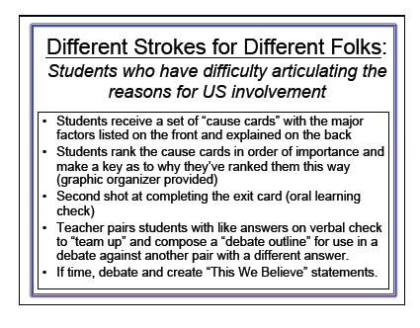

Slide 69

“Status of the Class” Checks
Techniques to use to survey
the entire class
for understanding.

Slide 70
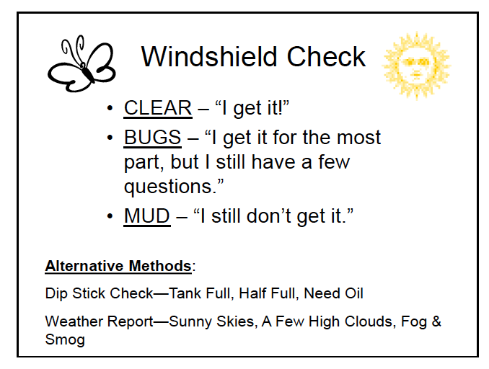

Slide 71
Squaring Off
Whole Group Assessment
1. Place a card in each corner of the room with one of the following words or phrases that are effective ways to group according to learner knowledge.
Rarely ever Sometimes Often I have it!
Dirt road Paved road Highway Yellow brick road
Tell the students to go to the corner of the room that matches their place in the learning journey.
Participants go to the corner that most closely matches their own learning status and discuss what they know about the topic and why they chose to go there.
Gregory, G.H. & Chapman, C. (2001). Differentiated Instructional Strategies: One Size Doesn’t Fit All. Thousand Oaks CA: Corwin Press.

Slide 72
Yes/No Cards
YES
NO
Using a 4x6 index card the student writes YES on one side and NO on the other.
When a question is asked the students hold up YES or NO.
Ask the students if they know the following vocabulary words and what they mean.
Call out a word. If a student is holding a YES they may be called on to give the correct answer.
Remind them that if they don’t know the words it is OK because they will be learning them.
You can do the same thing with conceptual ideas, etc.
Gregory, G.H. & Chapman, C. (2001). Differentiated Instructional Strategies: One Size Doesn’t Fit All. Thousand Oaks CA: Corwin Press.

Slide 73
Thumb It!
Have students respond with the position of their thumb to get an assessment of what their current understanding of a topic being studied.
Where I am now in my understanding of ______?
Up Sideways Down
I know a lot I know some I know very little
Gregory, G.H. & Chapman, C. (2001). Differentiated Instructional Strategies: One Size Doesn’t Fit All. Thousand Oaks CA: Corwin Press.

Slide 74
Fist of Five
Show the number of fingers on a scale, with 1 being lowest and 5 the highest.
Ask, How well do you feel you know this information?
I know it so well I could explain it to anyone.
I can do it alone.
I need some help.
I could use more practice.
1. I am only beginning.
Gregory, G.H. & Chapman, C. (2001). Differentiated Instructional Strategies: One Size Doesn’t Fit All. Thousand Oaks CA: Corwin Press.

Slide 75
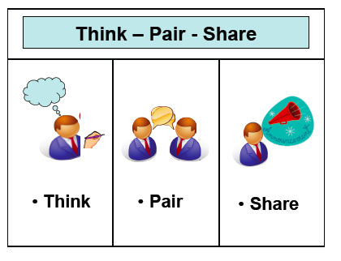

Slide 76
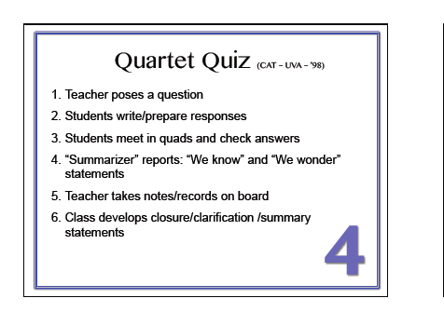

Slide 77
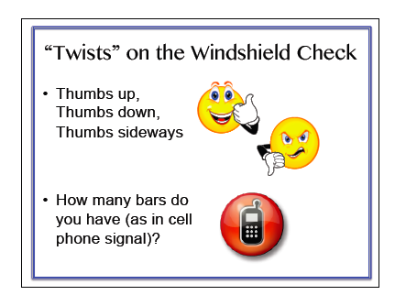

Slide 78
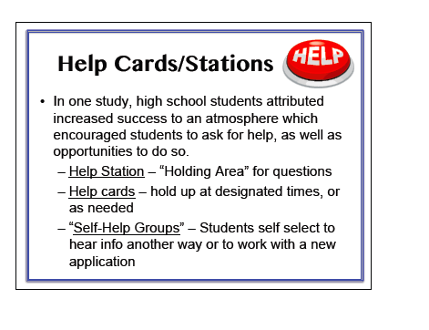

Slide 79
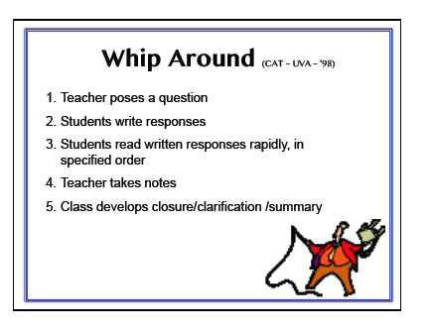

Slide 80


Slide 81


Slide 82


Slide 83


Slide 84


Slide 85


Slide 86


Slide 87


Slide 88


Slide 89


Slide 90


Slide 91


Slide 92


Slide 93


Slide 94


Slide 95


Slide 96


Slide 97


Slide 98


Slide 99


Slide 100


Slide 101


Slide 102


Slide 103


Slide 104


Slide 105


Slide 106
Intelligence Preference-Adjusting for Differences in Styles
Human brains are “wired” differently in different individuals. Although all normally functioning people use all parts of their brains, each of us is “wired” to be better in some areas than in others (Gardner, Sternberg).
Differentiation based on a student’s intelligence preference generally suggests allowing the student to work in a preferred mode and helping the student to develop that capacity further.
Sometimes teachers also ask students to extend their preferred modes of working, or they opt to use a student’s preferred areas to support growth in less comfortable areas.

Slide 107
Sternberg’s Three Intelligences
Creative
Analytical
Practical
We all have some of each of these intelligences, but are usually stronger in one or two areas than in others.
We should strive to develop as fully each of these intelligences in students…
…but also recognize where students’ strengths lie and teach through those intelligences as often as possible, particularly when introducing new ideas.

Slide 108
STERNBERG’S INTELLIGENCES
ANALYTICAL
Linear – Schoolhouse Smart - Sequential
PRACTICAL
Streetsmart – Contextual – Focus on Use
CREATIVE
Innovator – Outside the Box – What If
An idea for assessing students according to Sternberg’s intelligences would be to five the following scenario:
Imagine you are driving with your parents and they are listening to the radio. An interesting piece comes on about something you do not know. As you listen, you get more and more interested. What do you want to know?
Do you want to know all the little details that go into it?
Do you want to know how it is being used?
Do you want to know only enough information to think of other things to do?
Students who choose the first question fall into the analytic intelligence, the second corresponds to practical and those who choose the final question are the creative learners.

Slide 109
Creative Thinker
Attracted to novelty, likes to produce knowledge or ideas instead of consuming them, sees the world from a unique perspective, often prefers working alone, does not like to be rushed toward completion of tasks, often works in “bursts,” with long periods of incubation (which can look like unproductiveness) followed by quick, highly productive working periods, often has unique sense of humor.
Needs: support with setting deadlines and timelines, open-ended assignments with structure, assignments that allow for creative thinking and novel products, support working with other students, frequent outlets for creative thought, support with turning “ideas” into “reality.”

Slide 110
Analytical Thinkers
Likes to break things into its parts, likes to know how things work, enjoys facts as well as ideas, likes to argue, attracted to logical thinking and logical ideas, likes to “think” as opposed to “doing,” typically does well at school tasks, enjoys solving problems, can focus for long periods of time on a single task, may balk at “creative” assignments, likes to find one, right “answer,” may see things as black and white
Needs: assignments that require thought as opposed to rote memorization, extended assignments that allow for focused, long-term study, “problems” to figure out, time to discuss ideas with others, support with how to present ideas in a non-argumentative way, support with listening to and accepting others’ ideas, opportunities to struggle with open-ended questions that have no right/wrong answer

Slide 111
Practical Thinkers
Likes to see the real-world application of things, excellent at implementing plans, a “doer,” highly effective in making things “happen,” organized, less interested in ideas than in action, likes to move and do when learning, can be an excellent leader, may struggle with creativity-for-creativity’s-sake assignments, may resist completing assignments for which they see no real-world purpose, can work very well in group situations, may not be traditionally “book smart”
Needs: Hands-on activities, assignments that are connected to the real world, opportunities to share ideas with practitioners and experts, experiences with more creative, open-ended activities, support with being patient with activities for which they see no immediate application, opportunities to lead (even when they are not the highest achievers, these students can be highly effective at leading groups and delegating responsibilities)

Slide 112
I Like…
Designing new things
Coming up with ideas
Using my imagination
Playing make-believe and pretend games
Thinking of alternative solutions
Noticing things people usually tend to ignore
Thinking in pictures and images
Inventing (new recipes, words, games)
Supposing that things were different
Thinking about what would have happened if certain aspects of the world were different
Composing (new songs, melodies)
Acting and role playing
CREATIVE
Sternberg & Grigorenko, 2000
Notes:
How many of these statements describe you? Read list and mark ones you like to do

Slide 113
I Like…
Taking things apart and fixing them
Learning through hands on activities
Making and maintaining friends
Understanding and respecting others
Putting into practice things I learned
Resolving conflicts
Advising my friends on their problems
Convincing someone to do something
Learning by interacting with others
Applying my knowledge
Working and being with others
Adapting to new situations
PRACTICAL
Sternberg & Grigorenko, 2000
Notes:
Read list and mark ones you like to do

Slide 114
I Like…
Appealing to logic
Judging my & others’ behavior
Explaining difficult problems to others
Solving logical problems
Making inferences & deriving conclusions
Sorting & classifying
Thinking about things
ANALYTICAL
Analyzing characters when I’m reading or listening to a story
Comparing & contrasting points of view
Criticizing my own & others’ work
Thinking clearly & analytically
Evaluating my & others’ points of view
Sternberg & Grigorenko, 2000
Notes:
Read list and mark ones you like to do

Slide 115

Biology – A Differentiated Lesson Using Sternberg’s Intelligences
Learning Goals:
Know - Names of cell parts, functions of cell parts
Understand - A cell is a system with interrelated parts
Do – Analyze the interrelationships of cell parts/functions
Present understandings in a clear, useful, interesting and fresh
way.
After whole class study of a cell, students choose one of the following sense-making activities.
Analytical: Use a cause/effect chain or some other format you develop to show how each part of a cell affects other parts as well as the whole. Use labels, directional markers, and other symbols as appropriate to ensure that someone who is pretty clueless about how a cell works will be enlightened after they study your work.

Slide 116
Sternberg/Biology (cont’d)
Practical: Look around you in your world or the broader world for systems that could serve as analogies for the cell.
Select your best analogy (“best” most clearly matched, most explanatory or enlightening).
Devise a way to make the analogy clear and visible to an audience of peers, ensuring that they will develop clearer and richer insights about how a cell works by sharing in your work.
Be sure to emphasize both the individual functions of cell parts and the interrelationships among the parts.

Slide 117
Sternberg/Biology (cont’d)
Creative: Use unlikely stuff to depict the structure and function of the cell, with emphasis on interrelationships among each of the parts. You should select your materials carefully to reveal something important about the cell, it’s parts, and their interrelationships your ahas should trigger ours.
or
Tell a story that helps us understand a cell as a system with interdependent actors or characters, a plot to carry out, a setting, and even a potential conflict. Use your own imagination and narrative preferences to help us gain insights into this remarkable system.
Students share their work in a 3 format – first triads of students who completed the same option, then triads with each of the 3 categories represented.
This is then followed by a teacher-led, whole class discussion of cells as systems, then a “Teacher Challenge” in which the teacher asks students to make analogies or other sorts of comparisons between cells, cell parts, or interrelationships and objects, photos, or examples produced by the teacher.

Slide 118
Sternberg/ Biology continued
Process
Students share their work in a 3 format (2 times)–
  first triads of students who completed the same option,
  then triads with each of the 3 categories represented.
This is then followed by a teacher-led, whole class discussion of cells as systems, then a “Teacher Challenge” in which the teacher asks students to make analogies or other sorts of comparisons between cells, cell parts, or interrelationships and objects, photos, or examples produced by the teacher.
The teacher administers an end of chapter test that is the same for all.

Slide 119
Thinking About the Sternberg Intelligences
ANALYTICAL
Linear – Schoolhouse Smart - Sequential
Show the parts of _________ and how they work.
Explain why _______ works the way it does.
Diagram how __________ affects __________________.
Identify the key parts of _____________________.
Present a step-by-step approach to _________________.
PRACTICAL
Streetsmart – Contextual – Focus on Use
Demonstrate how someone uses ________ in their life or work.
Show how we could apply _____ to solve this real life problem ____.
Based on your own experience, explain how _____ can be used.
Here’s a problem at school, ________. Using your knowledge of ______________, develop a plan to address the problem.
CREATIVE
Innovator – Outside the Box – What If - Improver
Find a new way to show _____________.
Use unusual materials to explain ________________.
Use humor to show ____________________.
Explain (show) a new and better way to ____________.
Make connections between _____ and _____ to help us understand ____________.
Become a ____ and use your “new” perspectives to help us think about ____________.

Slide 120
Three States of Matter
KNOW: Three states of matter: solid, liquid, and gas
UNDERSTAND: All matter has both mass and volume.
DO: Distinguish one state of matter from the others.
Show how one state of matter changes to the others.
 | Choose three items from out classroom that are all in different states of matter. Show how each item is in a different state of matter in comparison to the other two items. Use terms like mass and volume to explain your answer. Use the idea of water, ice, and vapor to create a chart to show how these 3 things change from one state to another. Include condensation, evaporation, melting point, freezing point, expanding, and contracting in your chart.
 | Create three imaginative items to demonstrate different states of matter. Make an illustration of each item and explain why each one fit into the state it is in . Use mass and volume in your explanation. Make a visually appealing poster to teach second graders how each state changes into the other states. Be sure the way you teach is original. Show condensation, evaporation, melting point, freezing point, expanding, and contracting in your poster.
 | There are three mysterious objects in a box on a museum shelf. Their states of matter are not yet identified. Your task is to figure out the state of matter for each one. Design a museum exhibit for the 3. Use the terms mass and volume in your exhibit signs. There is a close friend of yours who does not understand how one state of matter changes into another. You want to help your friend out. Write out how you would explain to your friend using all this terms: condensation, evaporation, melting point, freezing point, expanding, and contracting. Make your explanation as clear as you can.
Analytical
Creative
Practical

Slide 121

A Science Example: Migration
Know: animals’ traits and needs
Understand: that animals migrate in order to meet their needs.
Be able to: trace an animal’s migratory path and explain why it follows
that pattern
Analytical – Find two animals that share a similar migration pattern. Chart their similarities and differences. Be sure to include information on each animal’s characteristics, habitat(s), adaptations, needs, migratory path, movement time frames, etc., as well as the reasoning behind these facts. Include an explanation as to why you think they share this pattern.
Practical – National Geographic has asked you to research the migratory habits of _________ (your choice). They would like you to share your findings with other scientists AND to offer them recommendations about the best manner of observing in the future. Be sure to include information on the animal’s characteristics, habitat(s), adaptations, needs, migratory path, movement time frames, etc., as well as the reasoning behind these facts. Include a “How To” checklist for future scientists to use in their research pursuits of this animal.
Creative – You have just discovered a new species of ____________. You have been given the honor of naming this new creature and sharing the fruits of your investigation with the scientific world via a journal article or presentation. Be sure to include information on this newly-discovered animal’s characteristics, habitat(s), adaptations, needs, migratory path, movement time frames, etc., as well as the reasoning behind these facts. Include a picture of the animal detailed enough that other scientists will be able to recognize it.
Kristi Doubet 05

Slide 122


A Basis in Learning Theory
Within one classroom, one might see, for example, Grade 3 students reading from the same pages of the anthology. Some read the text easily and are presented with no challenges. For others, the text is at an appropriate instructional level, but the students are not provided relevant instruction to more forward. For yet others, the text is well beyond their instructional level,
and they experience failure, and
reinforcement of negative attitudes
toward themselves and classroom
learning. This is one-size-fits-all
instruction.

Slide 123

A Basis in Learning Theory
Within another classroom, one might see students reading
different texts, having been matched to a text of an appropriate
level of difficulty by the teacher on the basis of ongoing assess-
ments of each student’s text level and in the light of the particular
objectives of the lesson. This is focused teaching. Needless
to say, both examples of one-size-fits-all instruction and focused
teaching can be found across all subjects and all grade levels.
Breakthrough (2006) by Fullan, Hill, Crevola - Joint Publication by Corwin, Sage, and Sage Pub.India • p. 35

Slide 124

What thoughts or insights
are you having now
that are new to you?

Slide 125

KEEP THINKING..KEEP WATCHING YOUR STUDENTS
KEEP LEARNING HOW TO MATCH CURRICULUM TO STUDENT NEEDS

